Slide 1
Minority/Women-Owned Business Enterprise Goals for NYS Grant Contracts
Notes:
Updated 3/17/16 by Justin Engel

Slide 2
MWBE Requirement for Grantees
The Department has established an MWBE goal of 30% on any grant contract valued over $25,000. This includes new contracts and renewal contracts.
The Department’s standard M/WBE participation goal for grants is 30% of eligible expenses.

Slide 3
What are Not-For-Profit Eligible Expenses?
Non Personal Services (NPS) costs in the budget that can be outsourced to a Minority and/or Women-owned Business Enterprise including:
Contractual Services
Equipment
Supplies

Slide 4
What are Municipality, Gov’t Entity or For-Profit Eligible Expenses?
All are eligible and the MWBE goal is applied to the entire amount of expenditures. If the goal % cannot be met a Form#2 MWBE waiver will be necessary.

Slide 5
What is expected of Grantee?
Review annual budget for MWBE eligible expenses
If an NFP - Establish total NPS eligible expenses within the three Supplies, Contractual and Equipment.
If any other entity type – the total value of expenditures is eligible

Slide 6
What is expected of Grantee?
For expenses identified as eligible, grantees should:
search the M/WBE directory http://www.esd.ny.gov/MWBE.html
determine where M/WBE participation is possible in NPS categories
Complete Form 1- Utilization Plan

Slide 7
What if I can’t meet 30% of eligible expenditures in Form 1?
Complete Form 2, Waiver Request
Form 2 requires the grantee to demonstrate due diligence in meeting the goal and generate applicable attachments. See Form 2 guidance for details.

Slide 8
Information for Subcontractors
If any of your existing subcontractors are eligible and interested in certification, the process is described below:
http://www.esd.ny.gov/MWBE/Qualifications.html
http://www.esd.ny.gov/MWBE/GetCertified.html

Slide 9
Summary of Steps
Complete Form 1.
Complete Form 2 if Form 1 does not propose a 30% goal.
Submit your forms to DOH as directed below.

Slide 10
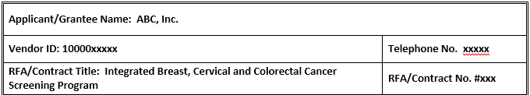
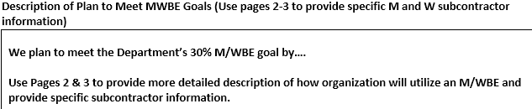
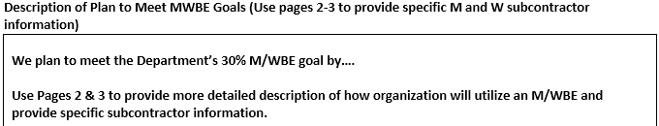
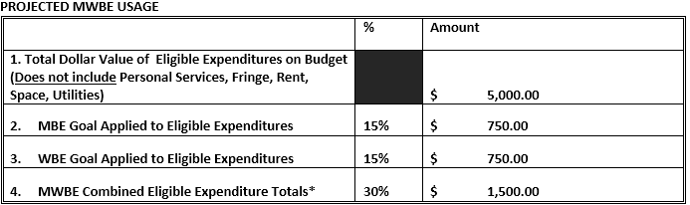
Example NFP Form 1:

Slide 11
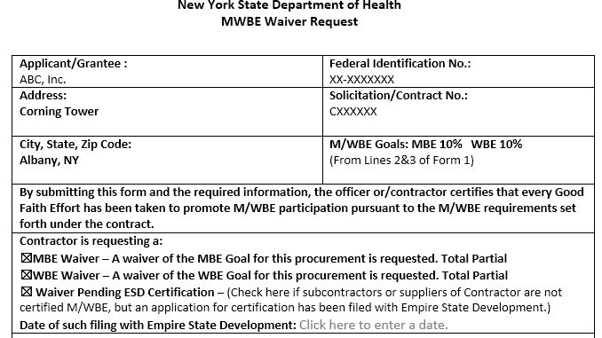
Example Form 2:
*Be sure to complete applicable attachments required with this Form.

Slide 12
Questions and Submission:
Questions regarding the completion of the forms should be directed to your contract manager.
Please have the forms completed, signed (if applicable), dated, and included with the submission of the COLA claim. Forms are not reviewed and approved in advance of the purchases subject to M/WBE. Rather the Budget Statement Report of Expenditures (BSROE) includes an additional attestation specific to M/WBE which must be completed and signed prior to submission of the claim.

